Slide 1

COMPUTER NETWORKS (BCSC 0008)
Copyright content, use only with the written permission of presenter mentioned
DATA LINK LAYER FLOW CONTROL

Slide 2
Disadvantage of Stop-and-Wait
In stop-and-wait, at any point in time, there is only one frame that is sent and waiting to be acknowledged.
This is not a good use of transmission medium.
To improve efficiency, multiple frames should be in transition while waiting for ACK.
Two protocol use the above concept,
Go-Back-N ARQ
Selective Repeat ARQ

Slide 3
Go-Back-N ARQ
We can send up to W frames before worrying about ACKs.
We keep a copy of these frames until the ACKs arrive.
This procedure requires additional features to be added to Stop-and-Wait ARQ.

Slide 4
Sequence Numbers
Frames from a sender are numbered sequentially.
We need to set a limit since we need to include the sequence number of each frame in the header.
If the header of the frame allows m bits for sequence number, the sequence numbers range from 0 to 2 ^{m} – 1. for m = 3, sequence numbers are: 1, 2, 3, 4, 5, 6, 7.
We can repeat the sequence number.
Sequence numbers are:
0, 1, 2, 3, 4, 5, 6, 7, 0, 1, 2, 3, 4, 5, 6, 7, 0, 1, …

Slide 5
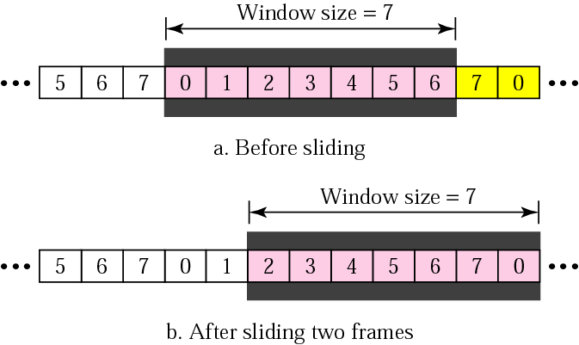
Sender Sliding Window
At the sending site, to hold the outstanding frames until they are acknowledged, we use the concept of a window.
The size of the window is at most 2^{m} -1 where m is the number of bits for the sequence number.
Size of the window can be variable, e.g. TCP.
The window slides to include new unsent frames when the correct ACKs are received

Slide 6
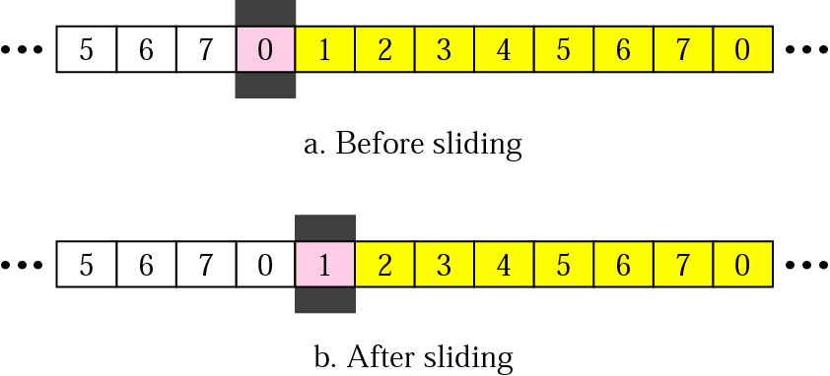
Receiver Sliding Window
Size of the window at the receiving site is always 1 in this protocol.
Receiver is always looking for a specific frame to arrive in a specific order.
Any frame arriving out of order is discarded and needs to be resent.
Receiver window slides as shown in fig. Receiver is waiting for frame 0 in part a.

Slide 7
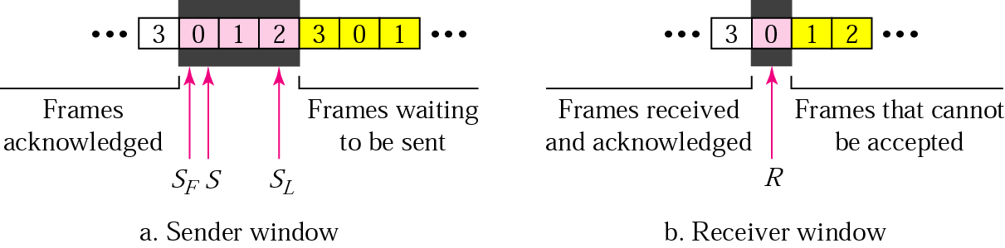
Control Variables
Sender has 3 variables: S, S_{F}, and S_{L}
S holds the sequence number of recently sent frame
S_{F} holds the sequence number of the first frame
S_{L} holds the sequence number of the last frame
Receiver only has the one variable, R, that holds the sequence number of the frame it expects to receive. If the seq. no. is the same as the value of R, the frame is accepted, otherwise rejected.

Slide 8
Acknowledgement
Receiver sends positive ACK if a frame arrived safe and in order.
If the frames are damaged/out of order, receiver is silent and discard all subsequent frames until it receives the one it is expecting.
The silence of the receiver causes the timer of the unacknowledged frame to expire.
Then the sender resends all frames, beginning with the one with the expired timer.
For example, suppose the sender has sent frame 6, but the timer for frame 3 expires (i.e. frame 3 has not been acknowledged), then the sender goes back and sends frames 3, 4, 5, 6 again. Thus it is called Go-Back-N-ARQ
The receiver does not have to acknowledge each frame received, it can send one cumulative ACK for several frames.

Slide 9
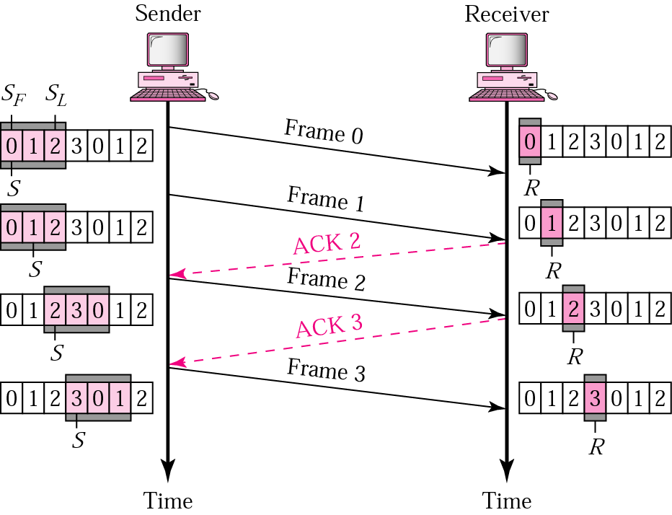
Go-Back-N ARQ, normal operation
The sender keeps track of the outstanding frames and updates the variables and windows as the ACKs arrive.

Slide 10
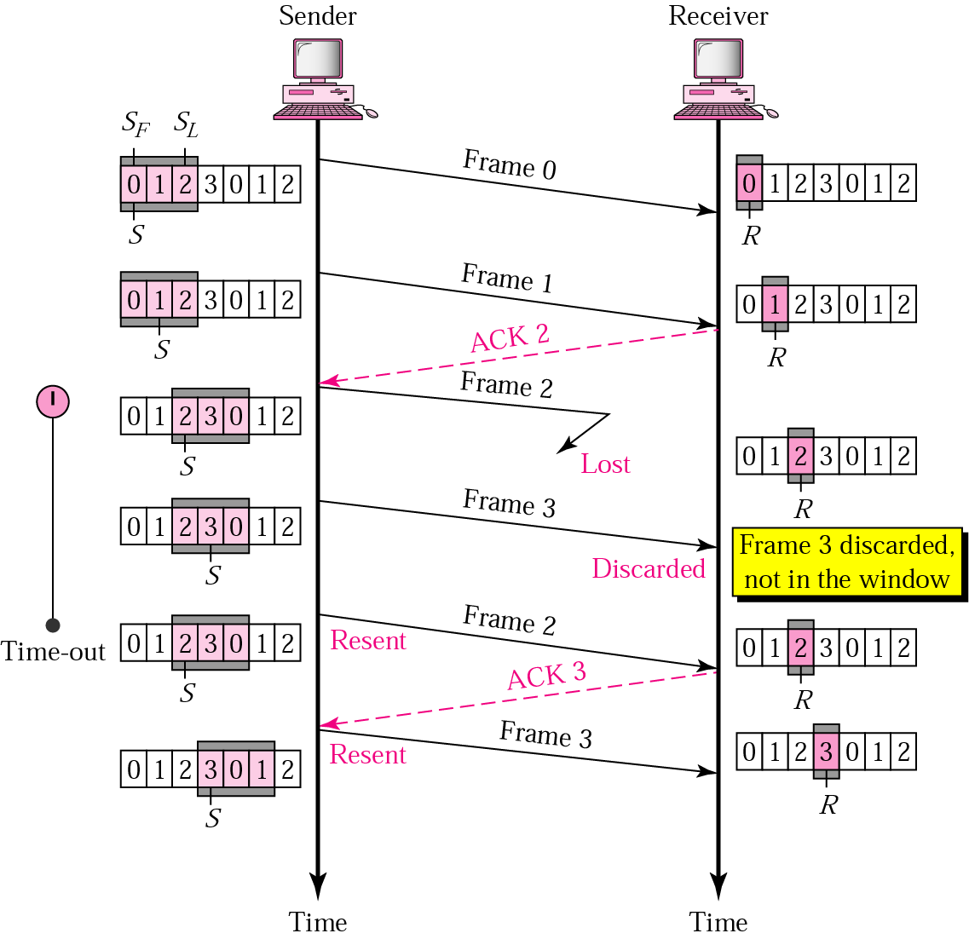
Go-Back-N ARQ, lost frame
Frame 2 is lost
When the receiver receives frame 3, it discards frame 3 as it is expecting frame 2 (according to window).
After the timer for frame 2 expires at the sender site, the sender sends frame 2 and 3. (go back to 2)

Slide 11
Go-Back-N ARQ, damaged/lost/delayed ACK
If an ACK is damaged/lost, we can have two situations:
If the next ACK arrives before the expiration of any timer, there is no need for retransmission of frames because ACKs are cumulative in this protocol.
If ACK1, ACK2, and ACk3 are lost, ACK4 covers them if it arrives before the timer expires.
If ACK4 arrives after time-out, the last frame and all the frames after that are resent.
Receiver never resends an ACK.
A delayed ACK also triggers the resending of frames

Slide 12
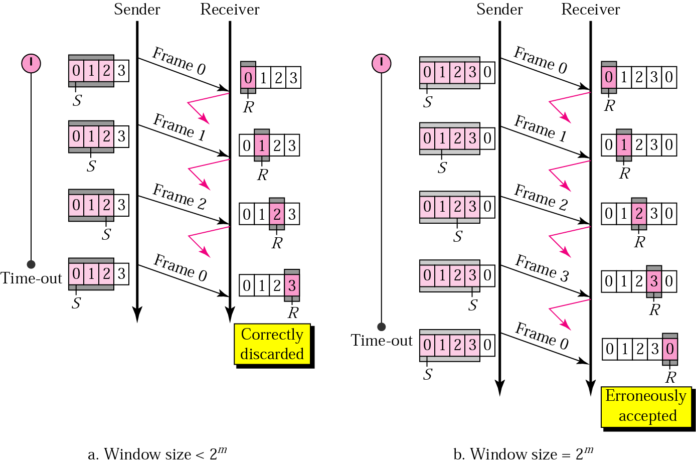
Go-Back-N ARQ, sender window size
Size of the sender window must be less than 2 ^{m}. Size of the receiver is always 1. If m = 2, window size = 2 ^{m} – 1 = 3.
Fig compares a window size of 3 and 4.
Accepts as the 1st frame in the next cycle-an error

Slide 13

Note
In the Go-Back-N Protocol, the sequence numbers are modulo 2^{m},
where m is the size of the sequence number field in bits.

Slide 14
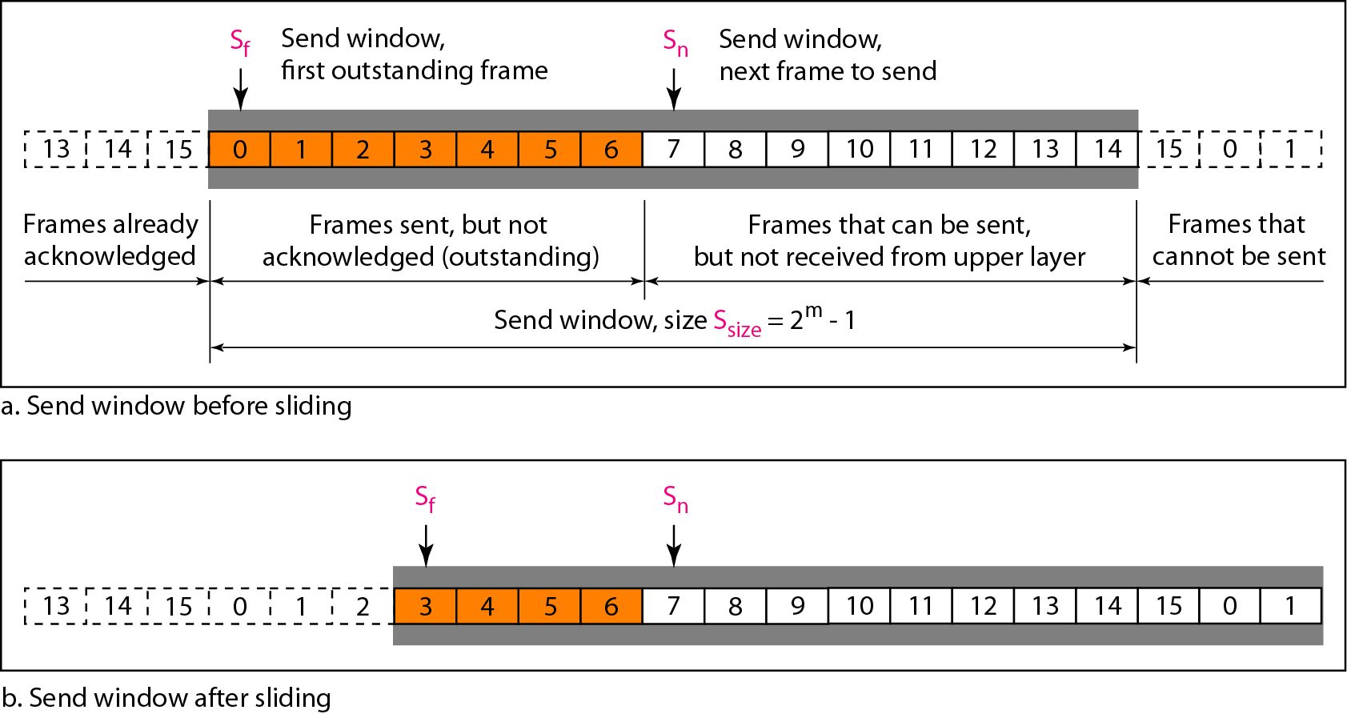
Figure 11.12 Send window for Go-Back-N ARQ

Slide 15
Note
The send window is an abstract concept defining an imaginary box of size 2^{m} − 1 with three variables: Sf, Sn, and S_{size}.

Slide 16
Note
The send window can slide one or more slots when a valid acknowledgment arrives.

Slide 17
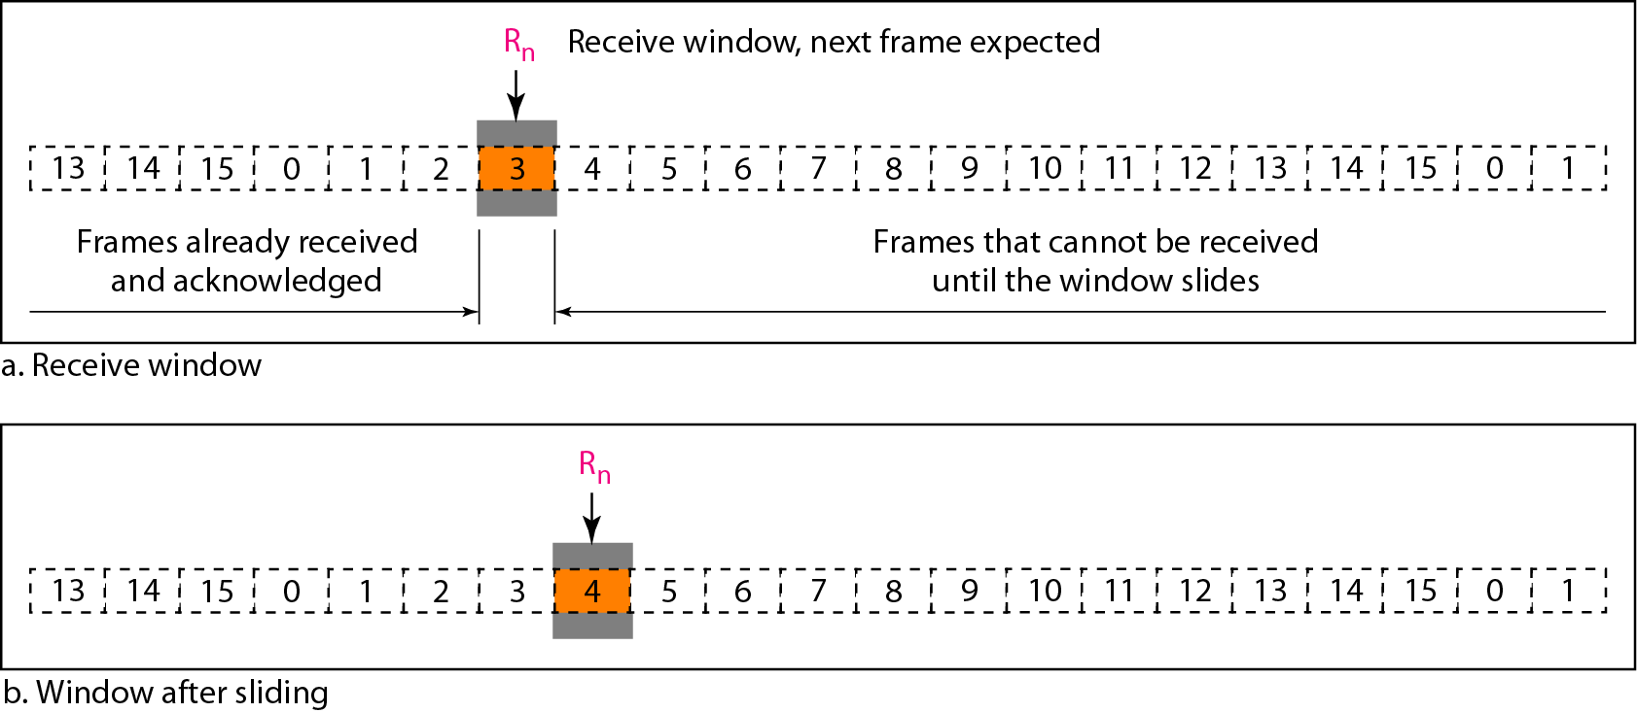
Figure 11.13 Receive window for Go-Back-N ARQ

Slide 18
Note
The receive window is an abstract concept defining an imaginary box
of size 1 with one single variable R_{n}. The window slides
when a correct frame has arrived; sliding occurs one slot at a time.

Slide 19
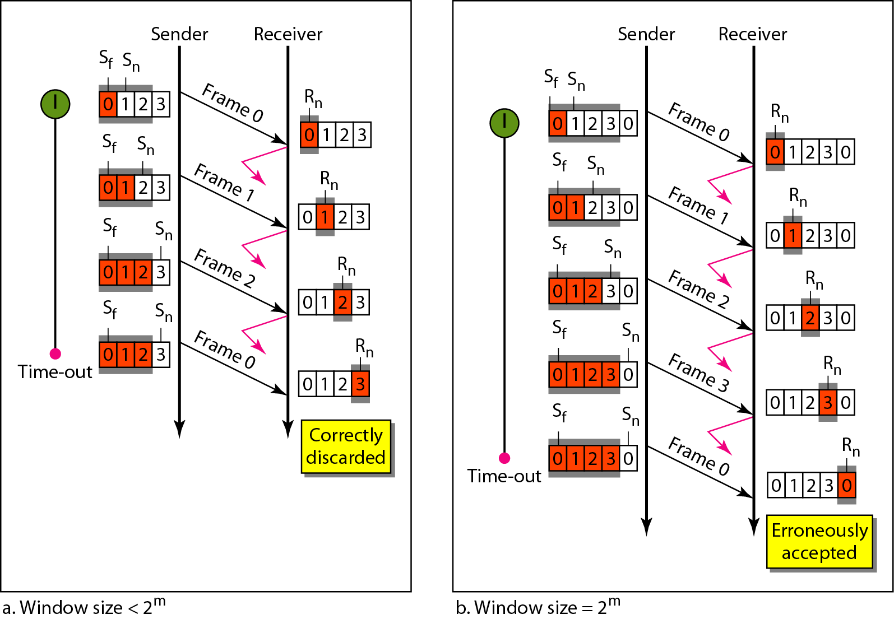
Figure 11.15 Window size for Go-Back-N ARQ

Slide 20
Note
In Go-Back-N ARQ, the size of the send window must be less than 2^{m};
the size of the receiver window is always 1.

Slide 21
Example 11.6
Figure 11.16 shows an example of Go-Back-N. This is an example of a case where the forward channel is reliable, but the reverse is not. No data frames are lost, but some ACKs are delayed and one is lost. The example also shows how cumulative acknowledgments can help if acknowledgments are delayed or lost. After initialization, there are seven sender events. Request events are triggered by data from the network layer; arrival events are triggered by acknowledgments from the physical layer. There is no time-out event here because all outstanding frames are acknowledged before the timer expires. Note that although ACK 2 is lost, ACK 3 serves as both ACK 2 and ACK 3.

Slide 22
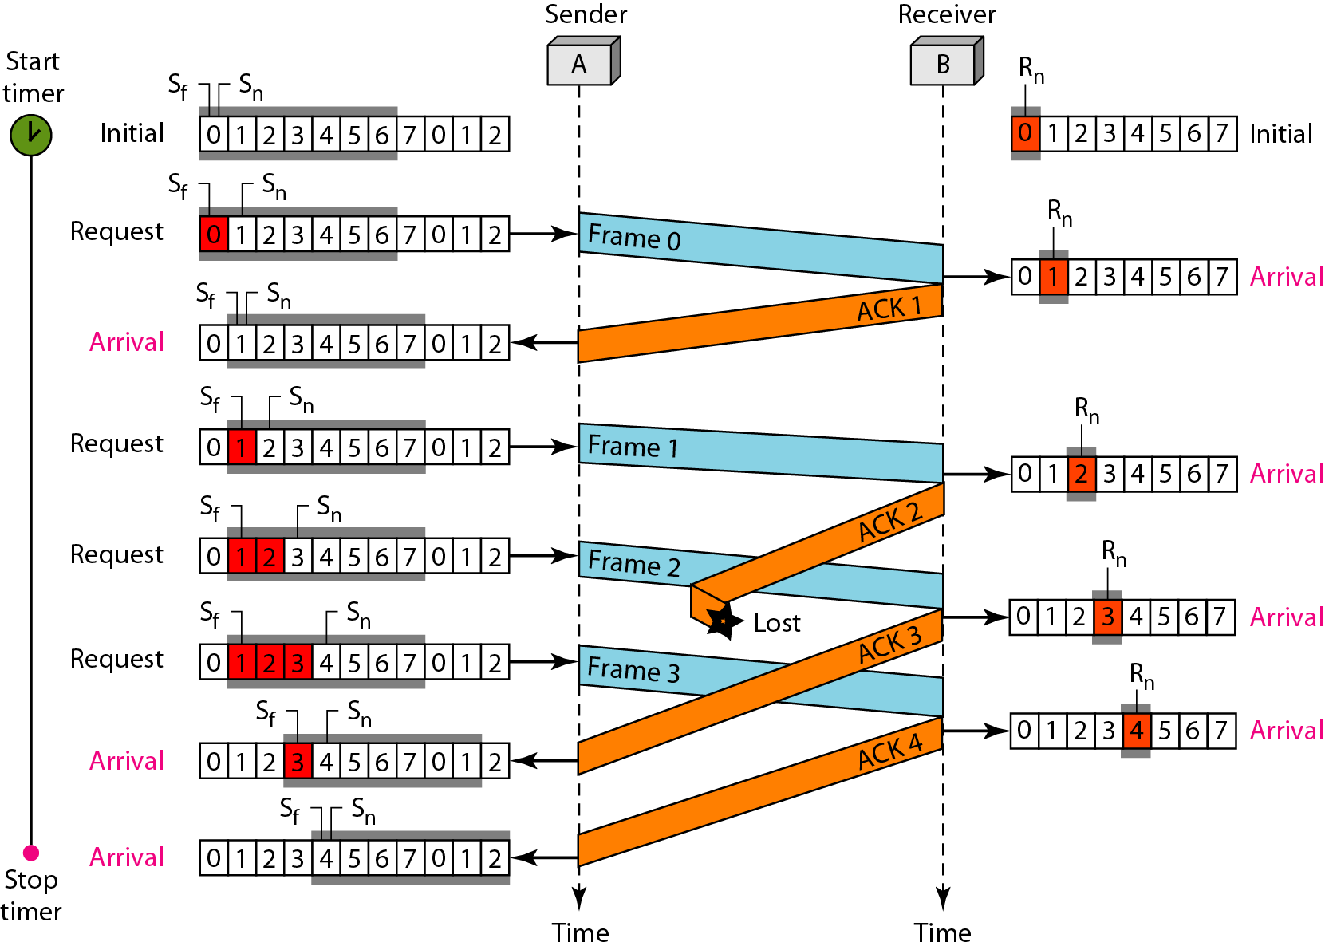
Figure 11.16 Flow diagram for Example 11.6

Slide 23
Example 11.7
Figure 11.17 shows what happens when a frame is lost. Frames 0, 1, 2, and 3 are sent. However, frame 1 is lost. The receiver receives frames 2 and 3, but they are discarded because they are received out of order. The sender receives no acknowledgment about frames 1, 2, or 3. Its timer finally expires. The sender sends all outstanding frames (1, 2, and 3) because it does not know what is wrong. Note that the resending of frames 1, 2, and 3 is the response to one single event. When the sender is responding to this event, it cannot accept the triggering of other events. This means that when ACK 2 arrives, the sender is still busy with sending frame 3.

Slide 24
Example 11.7 (continued)
The physical layer must wait until this event is completed and the data link layer goes back to its sleeping state. We have shown a vertical line to indicate the delay. It is the same story with ACK 3; but when ACK 3 arrives, the sender is busy responding to ACK 2. It happens again when ACK 4 arrives. Note that before the second timer expires, all outstanding frames have been sent and the timer is stopped.

Slide 25
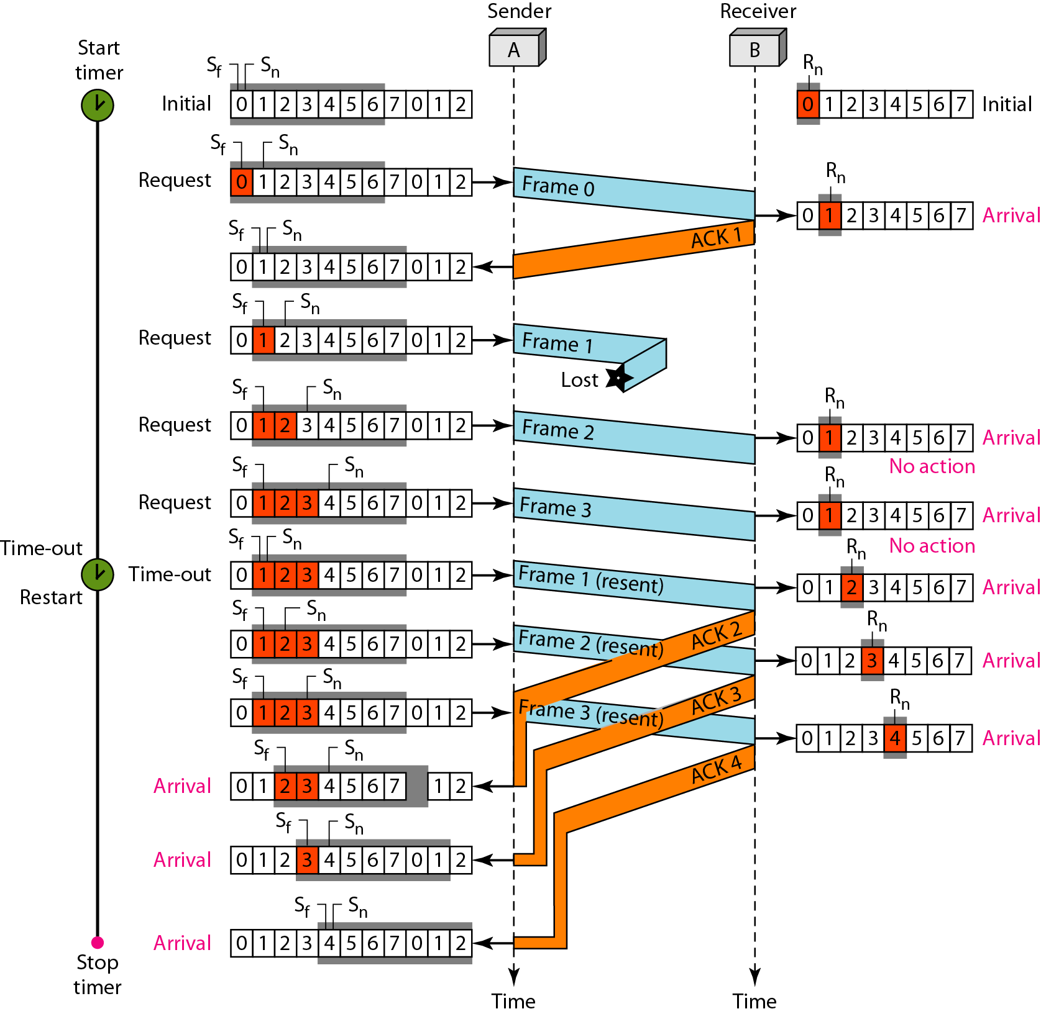
Figure 11.17 Flow diagram for Example 11.7

Slide 26
Note
Stop-and-Wait ARQ is a special case of Go-Back-N ARQ in which the size of the send window is 1.

Slide 27
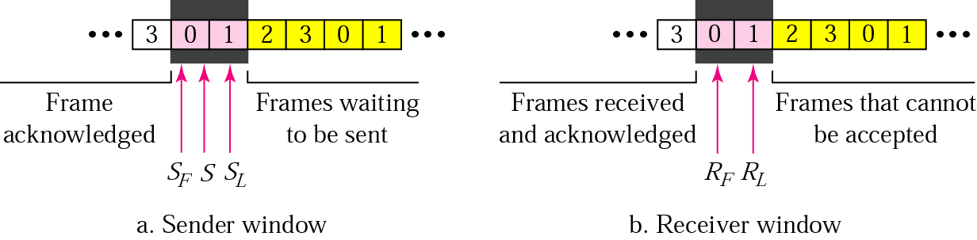
Selective Repeat ARQ, sender and receiver windows
Go-Back-N ARQ simplifies the process at the receiver site. Receiver only keeps track of only one variable, and there is no need to buffer out-of-order frames, they are simply discarded.
However, Go-Back-N ARQ protocol is inefficient for noisy link. It bandwidth inefficient and slows down the transmission.
In Selective Repeat ARQ, only the damaged frame is resent. More bandwidth efficient but more complex processing at receiver.
It defines a negative ACK (NAK) to report the sequence number of a damaged frame before the timer expires.

Slide 28
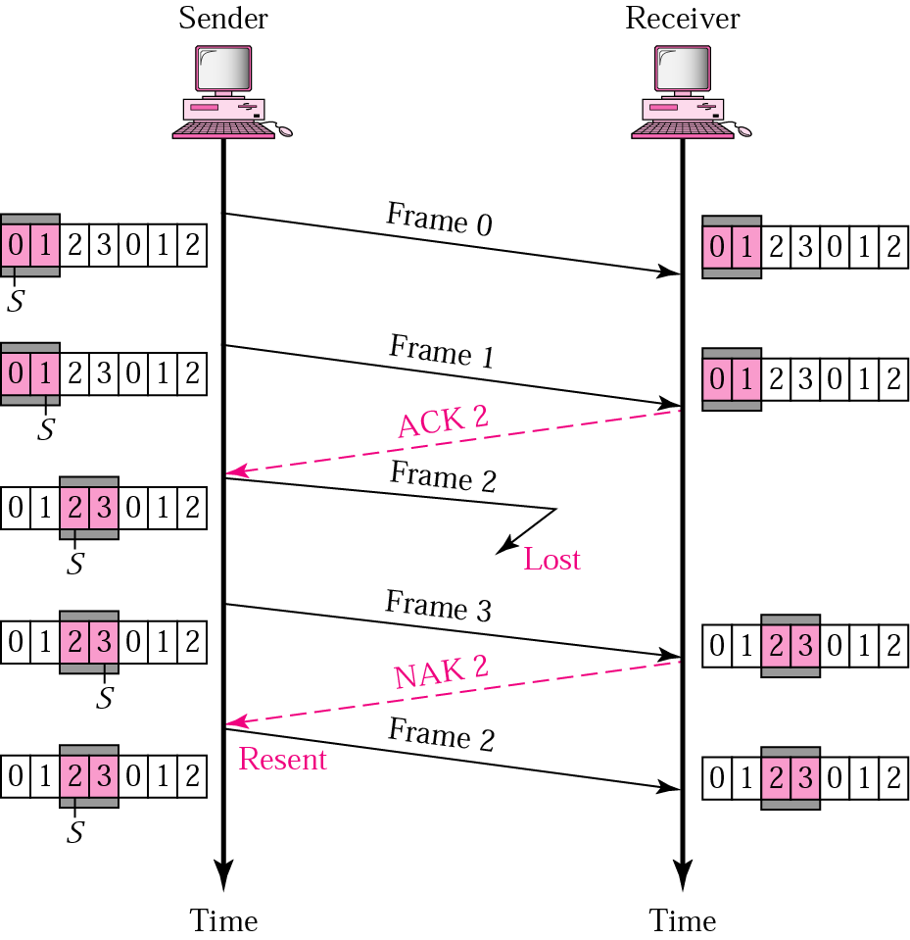
Selective Repeat ARQ, lost frame
Frames 0 and 1 are accepted when received because they are in the range specified by the receiver window. Same for frame 3.
Receiver sends a NAK2 to show that frame 2 has not been received and then sender resends only frame 2 and it is accepted as it is in the range of the window.

Slide 29
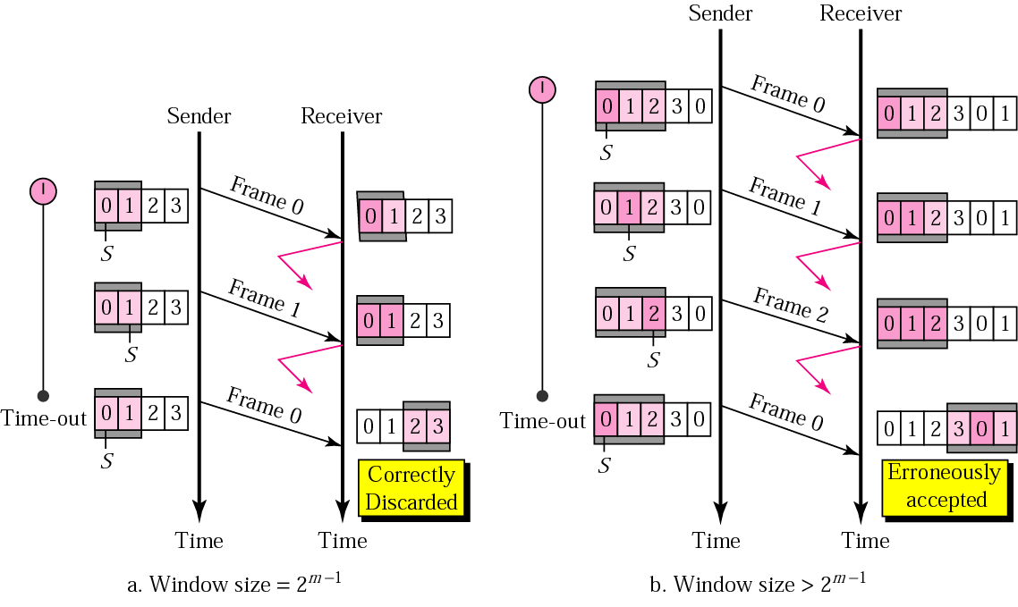
Selective Repeat ARQ, sender window size
Size of the sender and receiver windows must be at most one-half of 2 ^{m}. If m = 2, window size should be 2 ^{m} /2 = 2. Fig compares a window size of 2 with a window size of 3. Window size is 3 and all ACKs are lost, sender sends duplicate of frame 0, window of the receiver expect to receive frame 0 (part of the window), so accepts frame 0, as the 1st frame of the next cycle – an error.

Slide 30
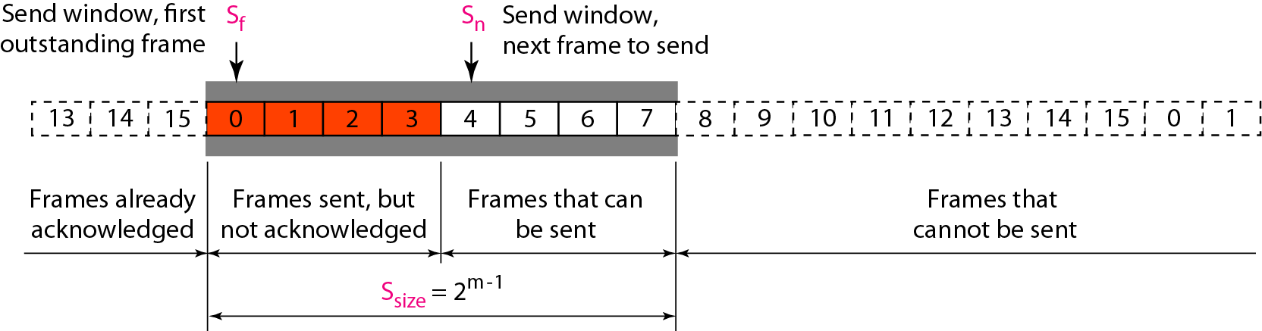
Figure 11.18 Send window for Selective Repeat ARQ

Slide 31
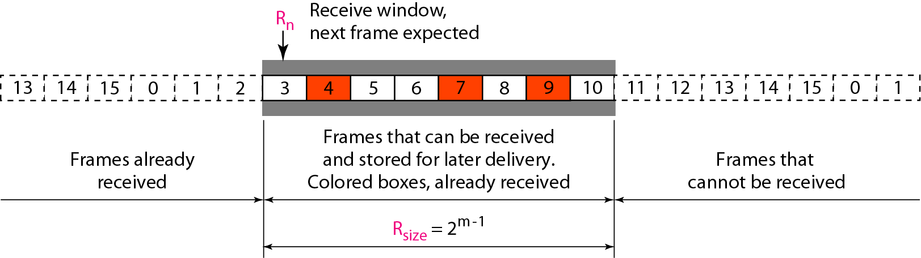
Figure 11.19 Receive window for Selective Repeat ARQ

Slide 32
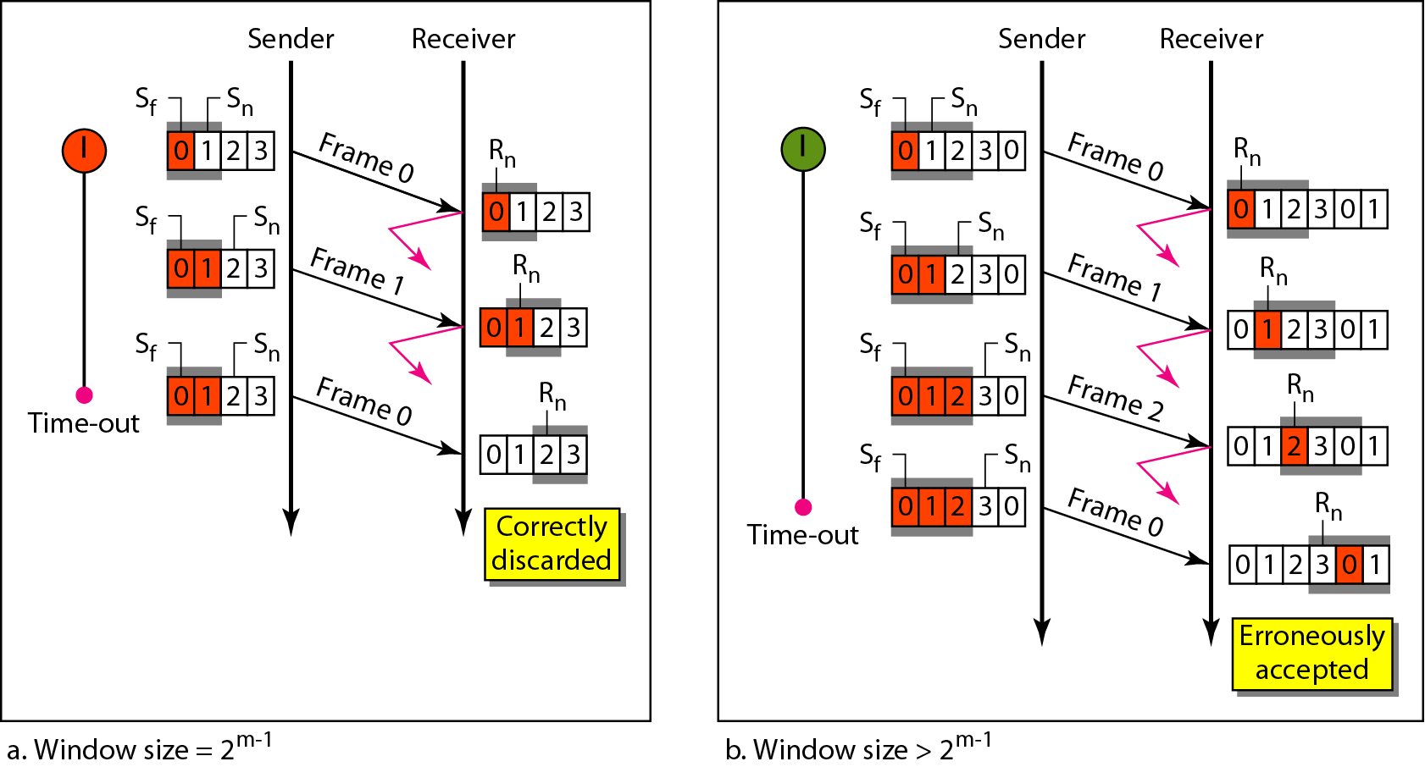
Figure 11.21 Selective Repeat ARQ, window size

Slide 33
Note
In Selective Repeat ARQ, the size of the sender and receiver window
must be at most one-half of 2^{m}.

Slide 34
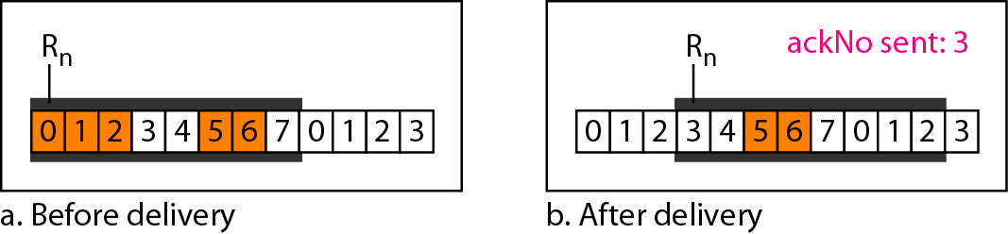
Figure 11.22 Delivery of data in Selective Repeat ARQ

Slide 35
Example 11.8
This example is similar to Example 11.3 in which frame 1 is lost. We show how Selective Repeat behaves in this case. Figure 11.23 shows the situation. One main difference is the number of timers. Here, each frame sent or resent needs a timer, which means that the timers need to be numbered (0, 1, 2, and 3). The timer for frame 0 starts at the first request, but stops when the ACK for this frame arrives. The timer for frame 1 starts at the second request, restarts when a NAK arrives, and finally stops when the last ACK arrives. The other two timers start when the corresponding frames are sent and stop at the last arrival event.

Slide 36
Example 11.8 (continued)
At the receiver site we need to distinguish between the acceptance of a frame and its delivery to the network layer. At the second arrival, frame 2 arrives and is stored and marked, but it cannot be delivered because frame 1 is missing. At the next arrival, frame 3 arrives and is marked and stored, but still none of the frames can be delivered. Only at the last arrival, when finally a copy of frame 1 arrives, can frames 1, 2, and 3 be delivered to the network layer. There are two conditions for the delivery of frames to the network layer: First, a set of consecutive frames must have arrived. Second, the set starts from the beginning of the window.

Slide 37
Example 11.8 (continued)
Another important point is that a NAK is sent after the second arrival, but not after the third, although both situations look the same. The reason is that the protocol does not want to crowd the network with unnecessary NAKs and unnecessary resent frames. The second NAK would still be NAK1 to inform the sender to resend frame 1 again; this has already been done. The first NAK sent is remembered (using the nakSent variable) and is not sent again until the frame slides. A NAK is sent once for each window position and defines the first slot in the window.

Slide 38
Example 11.8 (continued)
The next point is about the ACKs. Notice that only two ACKs are sent here. The first one acknowledges only the first frame; the second one acknowledges three frames. In Selective Repeat, ACKs are sent when data are delivered to the network layer. If the data belonging to n frames are delivered in one shot, only one ACK is sent for all of them.

Slide 39
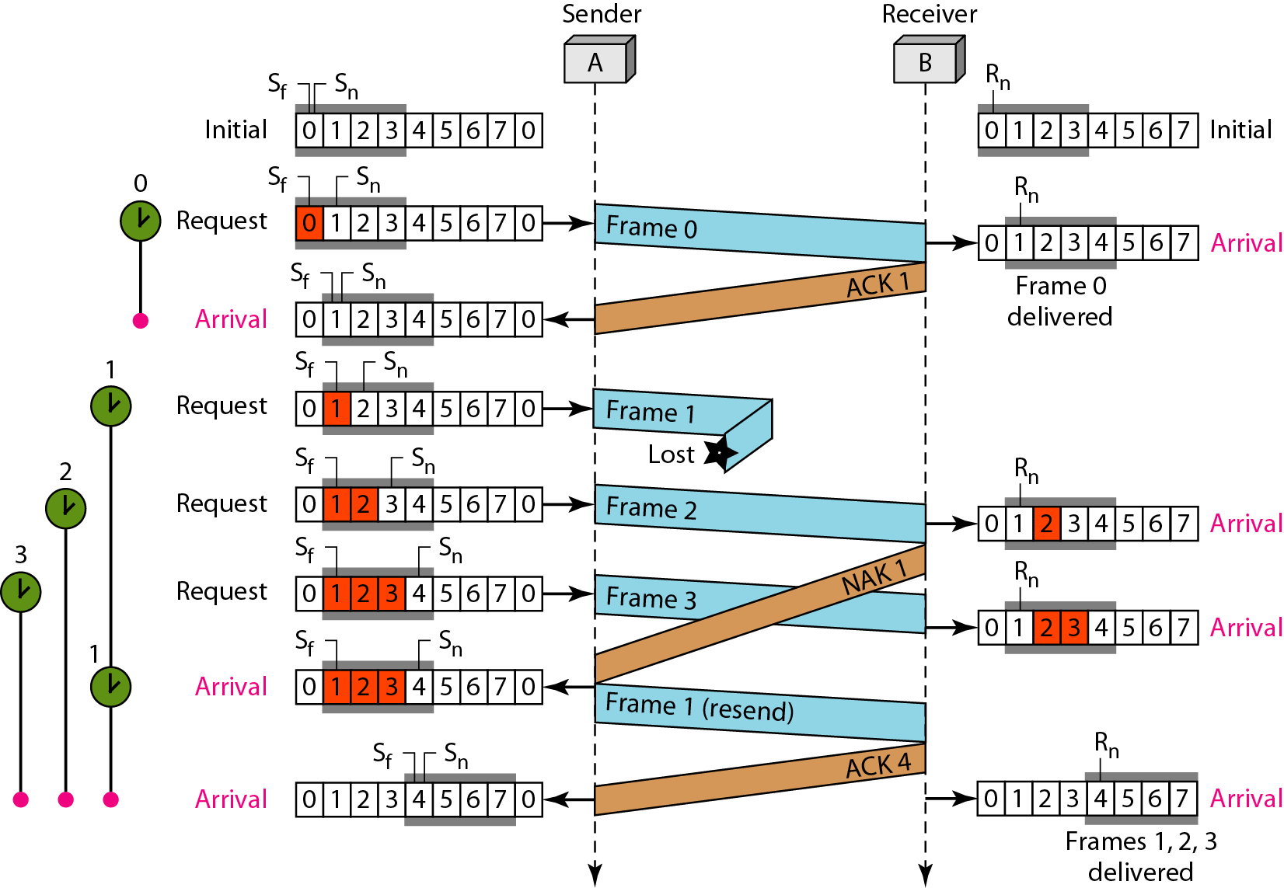
Figure 11.23 Flow diagram for Example 11.8

